Slide 1
Design and Analysis of
Algorithms
Jun Han
Prof. of Computing Science
BUAA

Slide 2

Staff
Lecturer:
Prof. Jun Han
Location:
G1112
Phone: 8231 6341
Email:
jun_han@buaa.edu.cn
Profile:
http://www.act.buaa.edu.cn/

Slide 3
Previous Sections
Divide and Conquer
Dynamic Programming
Greedy Algorithm
Probabilistic algorithm
Approximation algorithm
Backtrack Search

Slide 4
Following Sections
Lower Bound Arguments
NP Completeness
Local Search
Genetic Algorithm
Vertex Cover Problem
Group Assignment

Slide 5
Lower Bound Arguments

Slide 6
Lower Bounds
Definition: A lower bound of a problem is the least amount of computation that any algorithm must use to solve this problem.
Lower bounds are generally theoretically derived.
The lower bound for a problem is not unique, but the higher the better.
  For example, Ω(1), Ω(n) and Ω(nlogn) are all lower bounds for sorting but among them Ω(nlogn) is the best.

Slide 7
Lower Bounds
At present, if the best lower bound of a problem is Ω(n) and the time complexity of the best algorithm is O(n²). This means that
  we may try to find a better lower bound, e.g. Ω(nlogn);
  we may try to find a better algorithm, e.g. O(nlogn);
  both of the lower bound and the algorithm may be improved.
If the present lower bound is Ω(nlogn) and there is an algorithm with time complexity O(nlogn), then the algorithm is optimal.

Slide 8
Lower Bound Arguments
Trivial Lower Bounds
Information-Theoretic Arguments
Adversary Arguments
Problem Reduction

Slide 9
Lower Bound on Sorting
Comparison sort: A family of algorithms that use comparisons to determine the sorted order of a list.
Examples: Mergesort, Quicksort
Decision tree = A tree that describes the comparisons required to sort a list of data.

Slide 10
A < B < C A < C < B
B < A < C B < C < A
C < A < B C < B < A
A < B
B < A
A < B < C
A < C < B
C < A < B
B < A < C
B < C < A
C < B < A
A < C
C < A
B < C
C < B
A < B < C
A < C < B
C < A < B
B < A < C
B < C < A
C < B < A
B < C
C < B
A < C
C < A
A < B < C
A < C < B
B < A < C
B < C < A

Slide 11
Decision Trees
Given n items there are n! different ways to arrange them (permutation (排列)).
Only one of the permutations is in sorted order.
The aim of sorting is to discover the sorted permutation.
The worst case running time corresponds to the longest path from the root to a leaf.

Slide 12
The power of comparison
Given n, we have M = n! permutations.
Each permutation must appear as one of the leaves in the decision tree.
Every time we perform a comparison, one of two branches eliminates (排除) at most half of the permutations.

Slide 13
The power of comparison
Thus, if sorting is done along the longest path, we will use at least k = log₂M comparisons.
Another proof is that since any binary tree of height k has at most 2^{k} leaves, we have 2^{k}≥ n!.
The best general sorting algorithm requires log₂(n!) comparisons in the worst case.

Slide 14
How much is log₂(n!)?
Method 1
log₂(n!) = log₂(n (n−1) (n−2) … (2) (1))
= log₂n+log₂(n−1)+log₂(n−2)+ … +log₂(2)+log₂(1)
≥ log₂n+log₂(n−1)+log₂(n−2)+ … +log₂(n/2)
≥ n/2 log₂(n/2) = n/2 (log₂n – 1) = Ω(nlogn)

Slide 15
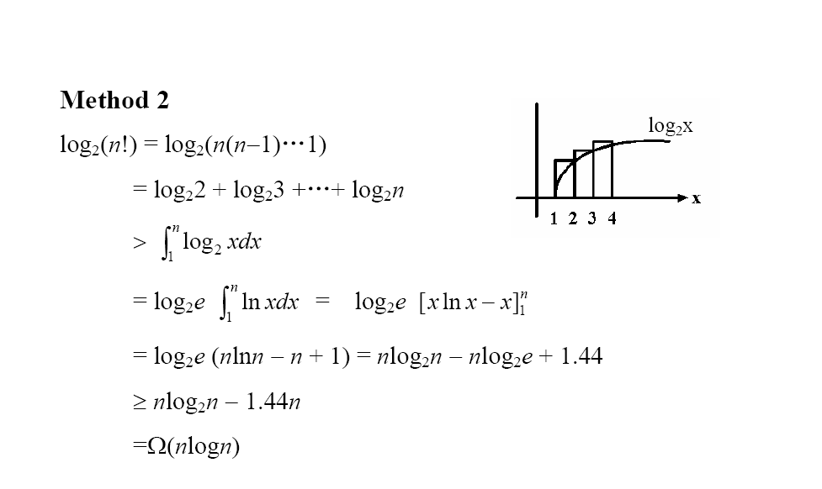

Slide 16
Comparison-based Sorting
Theorem 1. Any comparison-based sorting algorithm must use Ω(nlogn) comparisons for sorting an array of n elements in the worst case.
This means that it is impossible to perform sorting using O(n) or O(log n) or O(n log(log n)) comparisons.

Slide 17
Determining The Maximum
Theorem 2. Every comparison-based algorithm for determining the maximum of a set of n elements must use at least n/2 comparisons.
Proof. Every element must participate in at least one comparison; if not, the uncompared element can be chosen to be the maximum. Each comparison compares 2 elements. Hence, at least n/2 comparisons must be made.

Slide 18
Determining The Maximum
Theorem 3. Every comparison-based algorithm for determining the maximum of a set of n elements must use at least n−1 comparisons.
Proof. To say that a given element, x, is the maximum, implies that every other element has lost at least one comparison with another element (not necessarily x). Each comparison produces at most one loser. Hence at least n−1 comparisons must be used.

Slide 19
Lower Bound for Finding Max and Min
Remember: we can compute both the maximum and minimum of a list of n numbers, using (3/2)n−2 comparisons. We will prove that this solution is optimal.
Here is a simpler algorithm: Compare x[1] with x[2], x[3] with x[4], etc. We get n/2 maxima and n/2 minima. Find the maximum on the n/2 maxima with n/2−1 comparisons, and the same for the minima. The total cost: n/2+n/2−1+n/2−1 = 3n/2−2 (when n even).

Slide 20
Lower Bound for Finding Max and Min
Note that x is the minimum and y is the maximum only if
every element other than x has won at least one comparison and
every element other than y has lost at least one comparison.

Slide 21
Lower Bound for Finding Max and Min
Call a win “W”, a loss “L”. For each element, we label it according to the following 4 cases:
N: never compared with anybody;
W: won all comparisons;
L: lost all comparisons;
WL: won at least one and lost at least one.
The algorithm must assign n−1 W's and n−1 L's. i.e., it MUST need 2n−2 “units of information”.
More precisely, n-2 WL's, 1 W and 1 L.

Slide 22
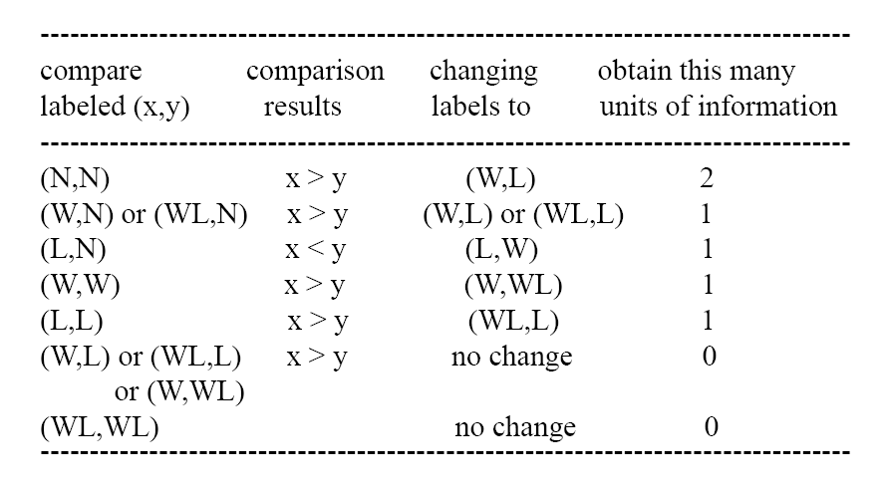

Slide 23
Lower Bound for Finding Max and Min
To prove that the worst case can happen, we will use what is called an adversary (反对者) argument (论证、论据). An adversary is an opponent (对手) that the comparison algorithm plays against.
Its ultimate (最终) goal is to maximize the number of comparisons that the algorithm makes (minimize the amount of information obtained) by constructing an input to the problem.

Slide 24
Lower Bound for Finding Max and Min
The adversary tentatively (暂时地) assigns values to the elements, which may change over time.
However, they can only change in a fashion CONSISTENT (一致的) with previous answers.
That is, an element labeled L may only DECREASE in value (since it has lost all previous comparisons, if it is decreased, it will still lose all of them), and an element labeled W may only INCREASE in value. An element labeled WL cannot change.

Slide 25
Lower Bound for Finding Max and Min
Theorem 4. Every comparison-base method for determining both the maximum and minimum of a set of n numbers must use at least (3n/2)−2 comparisons, in the worst case.
Proof. Assume n is even. As we have seen above, the algorithm must learn 2n−2 units of information. The most it can learn in one comparison is 2 units; but this can only happen in the case (N,N), in which both elements have never participated before in a comparison. This can only happen at most n/2 times. To learn the remaining n−2 units of information, the algorithm must perform n−2 comparisons in the worst case. The total number of comparisons is therefore at least n/2 + n−2 = (3/2)n−2.

